Slide 1





INSURANCE PROGRAM AUDIT & RENEWAL STRATEGY
Lyons Roofing
Presenter:
CCIG Property & Casualty Team
Commercial Lines Advisory
ccig.com
Denver • Austin • Phoenix
September 2026

Slide 2
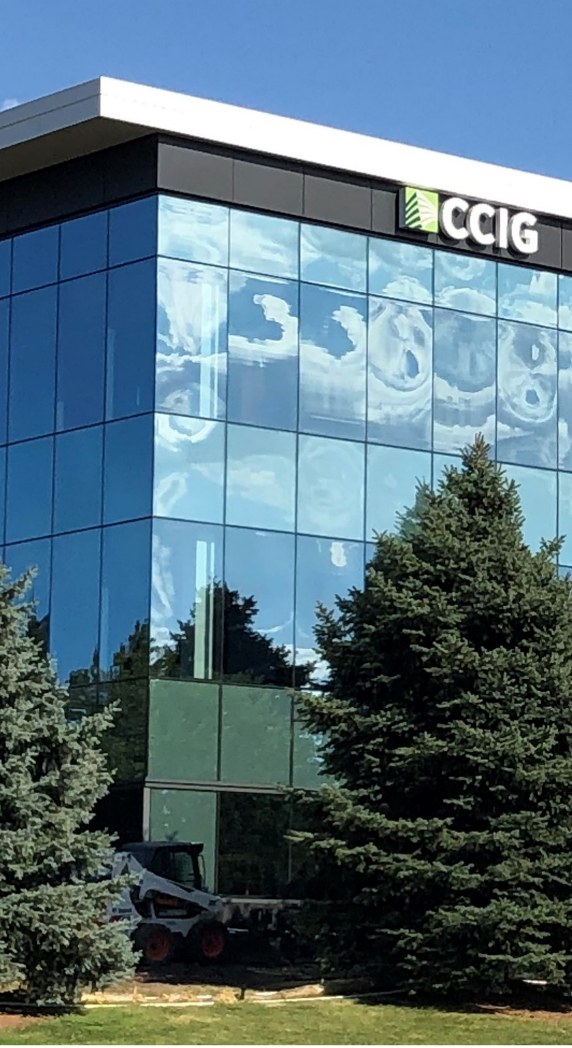
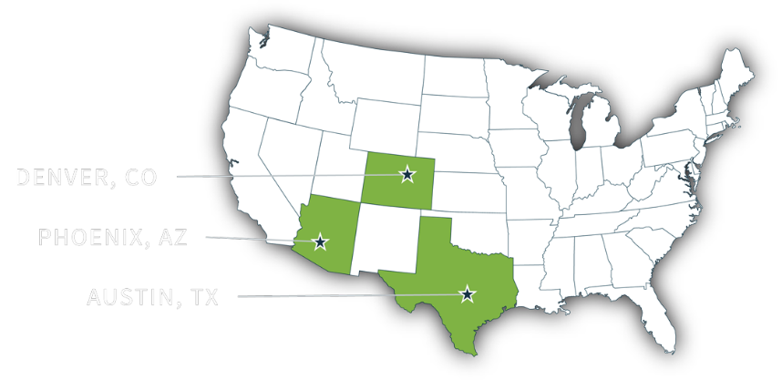
About CCIG
CCIG IS A FULL-SERVICE PRIVATE CLIENT, COMMERCIAL LINES, AND EMPLOYEE BENEFITS INSURANCE BROKERAGE.
Since 1985, CCIG has been a fiercely independent, rapidly growing insurance brokerage, delivering comprehensive risk management and insurance solutions to our diverse clientele. With a national presence, we employ over 100 seasoned insurance professionals and operate from our offices in Denver, CO, Austin, TX, and Phoenix, AZ.
PRIVATE CLIENT
PROPERTY & CASUALTY
EMPLOYEE BENEFITS
CCIG's Private Client Group consists of 17 insurance professionals. This group of high-caliber experts focuses exclusively on providing tailored, strategic risk management solutions for your lifestyle and financial milestones.
Family insurance program review, analysis, and recommendation summary.
Proactive renewal touchpoints at 60 days and 30 days before renewal.
CCIG provides the most comprehensive advice and tools needed to control costs and structure plans that meet the business’s strategic long-term goals.
We provide Program design and deductible optimization claims advocacy, claims reporting and trends, coverage review, and negotiation.
As well as safety Consulting, SAFE assessment, staff training, OSHA compliance, and cost containment programs.
We inspire our clients to think about healthcare in a new way, empowering them to take control of their future.
Our comprehensive approach includes care coordination, third-party administration, tailored stop-loss coverage, prescription benefits management (PBM), and cost-containment strategies.
With data we collect through our partners and actuaries, we paint a picture of both the present and the future to drive the direction of changes to the benefit program.
© CCIG All Rights Reserved
2

Slide 3
Executive Summary
General Observations: A Fragmented Program
  The program is spread across 10 different insurance carriers, which expressly opens it to gaps in coverage — named insureds, retentions/deductibles, definitions, and claims handling must all dovetail across every one of them.
  Ten carriers means ten sets of invoices, billing departments, due dates, claims adjustors, and underwriters — a large administrative burden for your team.
  This fragmentation also impedes Lyons' ability to leverage premium and coverage effectively.

Slide 4
Executive Summary
General Observations: The Cost of Mono-Line Coverage
  Many ancillary coverages (CNA, Hanover, Cyber, etc.) are stand-alone, mono-line policies, each with a different carrier.
  This diminishes Lyons' negotiating power and lets carriers place responsibility for a claim on each other.
  Every additional stand-alone policy adds its own policy taxes, stamping fees, and broker fees — increasing Lyons' insurance costs unnecessarily.

Slide 5
Executive Summary
Realistic Objective: 10 Carriers → 4–5 Carriers
  Consolidating to 4–5 carriers (carrier willingness and strategic approach permitting) increases Lyons' leverage.
  Fewer carriers means simpler billing and a tremendous decrease in administrative burden.
  A moderate, likely decrease in premium expense follows as a secondary benefit.

Slide 6

Analysis of Current Program
Key Audit Findings
© CCIG All Rights Reserved
6

Slide 7
Property & Inland Marine
  Review replacement costs for Furniture, Fixtures, Stock/Inventory, and Machinery/Equipment — Agreed Value addresses the 90% co-insurance penalty, but a claim payout is still capped at the stated limit.
  The Tucson location should be removed from the policy — confirm whether a lease has been signed for a replacement location.
  The $25,000 Installation Floater limit should be reconfirmed; it may be insufficient for current operations.

Slide 8
Commercial General Liability: Coverage Exclusions
The General Liability policy carries at least three, and possibly four, exclusions that materially narrow Lyons' coverage.
Exclusion | What's Excluded | Why It Matters
New Entities | Newly formed or acquired entities are not automatically covered | Any new Lyons/Canopy entity is unprotected until it is added
Exterior Insulation & Finish Systems (EIFS) | Work involving EIFS/stucco systems | A common exterior exposure carries no GL protection
Condominium, Townhome & Tract Exclusion | Multi-family and tract housing projects | A large share of residential roofing work may fall outside coverage
Open Roof / Roofing Operations Endorsement | Active roofing operations exposure | The core scope of Lyons' business may be excluded

Slide 9
CGL: Professional Liability & Deductible Exposure
  No apparent coverage for Contractor's Professional Liability — a gap if Lyons prepares, approves, or recommends drawings, specs, change orders, or hazard-assessment plans.
  Also a gap if Lyons performs supervisory, inspection, training, or engineering services, or commercial/industrial hygiene, air monitoring, or consulting work.
  A $10,000 per-occurrence deductible applies to every Bodily Injury, Property Damage, Personal Injury, and Advertising Injury claim.

Slide 10
Unmanned Aircraft Systems (Drone Liability)
  The only evidence on file is an APPLICATION for drone liability coverage — not a bound policy.
  The application expressly states that no insurance is afforded on the basis of the application alone.
  This could put Lyons out of compliance with contractual drone-liability obligations owed to customers.

Slide 11
Crime / ERISA / Employee Theft
  The current fidelity bond limit is $200,000 — is this figure still accurate?
  Recommend confirming when the bond amount was last corroborated against the retirement plan's current asset value.
  An outdated bond limit can leave the plan and its fiduciaries under-protected.

Slide 12
Workers' Compensation: Experience Mod Swing
A combined swing of roughly 35% — before any base-rate changes are applied.
*Loss of the prior year's credit modification factor, combined with the new debit, equals an approximate 35% increase in Workers' Comp expense on the mod alone.
Has leadership been notified of this increase ahead of the renewal?
Notes:
I need updated data

Slide 13
Commercial Umbrella / Excess Liability: Duplication & Gap
Two excess liability policies appear to duplicate coverage while leaving a critical residential-work gap.
Excess Policy | Limit / Attaches Over | Annual Premium
Policy 1 | $6,000,000 — sits only over the Business Auto policy | $55,000
Policy 2 | $5,000,000 — sits only over Commercial General Liability; excludes all residential work except apartments | $25,000
Neither excess policy sits in excess of Employers' Liability (Workers' Compensation, Part Two) — and current Certificates of Liability Insurance do not reflect this structure, evidencing inaccurate coverage information.

Slide 14
Named Insureds Missing
The Most Alarming Exposure to Risk — Immediate Action Needed
  Multiple Canopy Home Services operating and holding entities are not confirmed as named insureds across the program.
  As drafted, any unnamed entity has no coverage for General Liability, Auto, or Workers' Compensation claims.
  Unnamed entities also have no protection under any Excess/Umbrella, Drone, Cyber, EPLI, D&O/Fiduciary, or Pollution Liability policy.

Slide 15
Named Insureds Missing: Coverage Gap Matrix
Per the Canopy Home Services ownership structure, every coverage line below currently excludes any entity not listed as a named insured.
Coverage Line | Status for Unlisted Entities | Action Needed
General Liability | No coverage | Add as named insured
Business Auto | No coverage | Add as named insured
Workers' Compensation | No coverage | Add as named insured
Excess / Umbrella Liability (all policies) | No coverage | Add as named insured
Unmanned Aircraft (Drone) Liability | No coverage | Add as named insured
Cyber Liability | No coverage | Add as named insured
Employment Practices Liability | No coverage | Add as named insured
Directors & Officers / Fiduciary Liability | No coverage | Add as named insured
Pollution Liability | No coverage | Add as named insured

Slide 16
Appendix: Referenced Documentation
Findings throughout this presentation are supported by the following policy documents and exhibits.
# | Source Document | Referenced Pages
1 | 2526 CPKG Policy – Selective | Pg. 1 of 253; pp. 45, 54, 55
2 | 2526 GL Policy – United Specialty | pp. 2, 3, 4, 24, 28, 31, 46, 61, 62–63
3 | Policy 956313 – May 26, 2026 | pp. 1, 2
4 | 2526 Crime Policy | pp. 1, 11
5 | 2526 Cyber Policy – At Bay | p. 3
6 | 2526 Pollution Policy – UCPM | p. 4
7 | 2526 WC Policy – Copperpoint / Canopy Roofing, LLC | pp. 2, 3, 4 (policy); pp. 1, 2 (Canopy Roofing, LLC)
8 | 2526 Excess Auto Policy – RSUI | pp. 1, 2, 3
9 | 2526 Excess GL – Commercial | pp. 3, 4, 22 (Residential Work Exclusion)
10 | Owens Corning & Subsidiaries Documentation | p. 1
11 | Canopy Ownership Summary | Both pages (Word document)

Slide 17
Questions & Next Steps
Realistic objective: consolidate to 4–5 carriers for greater leverage, simpler billing, and a lighter administrative load.

